Slide 1
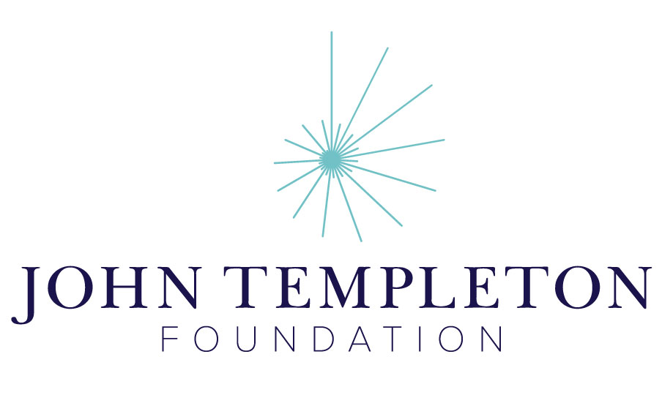
4.3 The Modern State and Human Rights
Madrasa Discourses
Module 4: The Grand Cosmos
and the Human Person

Slide 2
4.3 Summary
The advent of western modernity—at once both a period in time and a self-promoting narrative—brought with it shifts in the dominant forms of political and social organization. Now the world’s communities operate within the nation-state system, where self-defined (and shifting) groupings of people jostle for internationally-sanctioned territorial dominance. How have scripture and tradition been mobilized in this context of pluralism? What resources does tradition hold for the protection of human dignity?

Slide 3
4.3 Big Questions
How has modernity changed our political and community identities?
How has scripture been mobilized for and against political and national goals?
Can Islam be invoked to protect more human rights than secular human rights regimes?

