Slide 1
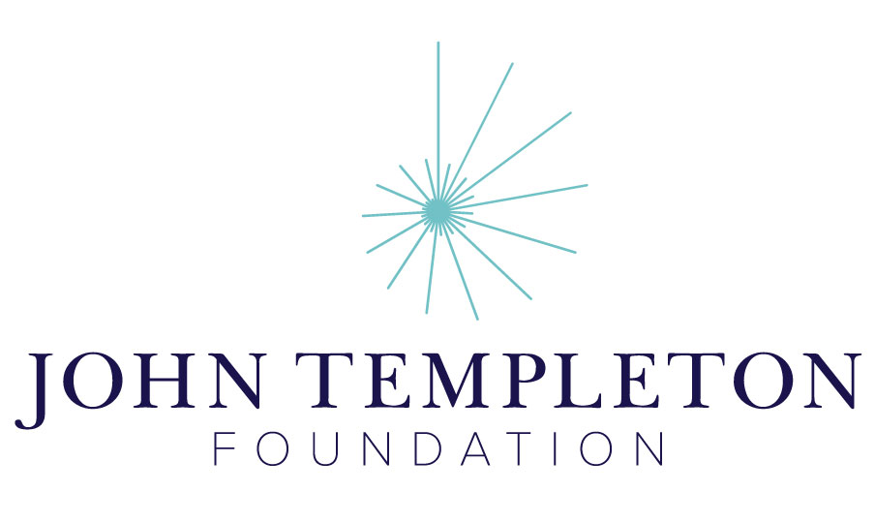
1.1 Creation Stories
Madrasa Discourses
Module 1: Conceptualizing the Past

Slide 2
1.1 Summary
We begin by reading creation myths from around the world, comparing these myths to the Abrahamic story of creation as well as to the new story of the universe being told by science. Learners are invited to think about why they would consider any one of these stories, such as the Abrahamic story, as true, while the others are not, and whether the truth of the story is literal or non-literal. We turn to an Islamic theologian from the tenth century, Abū Manṣūr Māturīdī (d. 944 C.E.), to see how he approaches some of these questions.
Notes:
In the very first section of this module, we invite you to ask some of these questions: [read questions]

Slide 3
1.1 Big Questions
Why do we have so many different stories about our origins? Where do these stories come from?
Are the stories to be read literally or allegorically? Is any one of them truer than another?
Does the Abrahamic story sound more compelling than the others? Why or why not?
In what ways does the scientific story differ from the rest? In what ways is it similar?
What does the multiplicity of these stories tell us about human nature, and what do they tell us about God?
Notes:
In the very first section of this module, we invite you to ask some of these questions: [read questions]

Slide 4
1.1 Resources
In order to explore these questions, we provide access to texts, videos, and online resources. Some of these are embedded in our website, but some require you to visit other websites. Our team has made sure that the external links are safe and credible. If a resource is in another language such as Arabic, you may refer to the left margin for an abridged summary in English.

